Slide 1

A Review in the Disease Behavior of Covid-19
Christopher Torres

Slide 2
Genomewide Association Study of Severe Covid-19 with Respiratory Failure
David Ellinghaus, Ph.D.,
Frauke Degenhardt, M.Sc.,
Luis Bujanda, M.D., Ph.D.,
Maria Buti, M.D., Ph.D.,
for The Severe Covid-19 GWAS Group
Considerable variation in disease behavior world-wide
Goal – identification of potential genetic factors for developing the disease
Study on 1980 patients among Italy and Spain in 7 hospitals
After quality control and the excluding outliers, 835 patients and 1255 control participants from Italy, 775 patients and 950 control participants from Spain used in the final analysis.
Analyzed 8,582,968 single-nucleotide polymorphisms and conducted a meta-analysis of the two case–control panels.

Slide 3
Single-nucleotide Polymorphisms
A DNA sequence variation occurring when a single nucleotide adenine, thymine, cytosine, or guanine, in the genome differs between members of a species or paired chromosomes of an individual.
For example, two sequenced DNA fragments from different individuals, AAGCCTA to AAGCTTA, contain a difference in a single nucleotide. In this case we say that there are two alleles: C and T. Almost all common SNPs have only two alleles.
Allele - one of two or more alternative forms of a gene that arise by mutation and are found at the same place on a chromosome.

Slide 4
Results
ABO blood group
A blood-group-specific analysis showed a higher risk in blood group A
A protective effect was found in blood group O
Identified a gene cluster as a genetic susceptibility locus in patients with Covid-19 with respiratory failure and confirmed a potential involvement of the ABO blood-group system

Slide 5
DNA Could Hold Clues to Varying Severity of COVID-19
According to the article those who do experience symptoms of the Corona virus have experienced symptoms such as loss of smell or taste, pink eye, digestive issues, fever, cough, pneumonia, septic shock, multi-organ failure and difficulty breathing down to the point of respiratory failure.
It’s also been noted that men and elderly with pre-existing conditions such as heart disease are also more vulnerable, but that has not stopped hundreds of young healthy individuals from succumbing to the virus as well.
14% of confirmed cases have been “severe.”
2.3% of confirmed cases have resulted in death
10.5% is the fatality rate for people with cardiovascular disease
7.3 % for individuals with diabetes
6% for those with chronic respiratory disease, hypertension, or cancer

Slide 6
Poor Immune Systems
Its been noted that generally when Covid starts causing damage in the airway, the immune systems triggers a wave of local inflammation, recruiting immune cells to eradicate the pathogen. Once there is a positive response the immune response recedes, and the patients recover.
For still unknown reasons, an uncontrolled immune response triggers an overproduction of immune cells and their signaling molecules leading to a cytokine storm associated with a flood of immune cells into the lungs, which lead to respiratory failures.

Slide 7
What do we know? “Basically nothing.”
“I think we’re so bad at predicting [which genes matter]. We’ve been terrible in the past and I think a lot of it is because we don’t fully understand everything that’s going on in the immune system,” says Dr. Wendy Chung, a clinical geneticist and physician at Columbia University
Still difficult to explain why healthy people, especially young healthy individuals dying from the disease.

Slide 8
Where New Mexico Stands Today Where The Navajo Nation Stands Today
12, 147 positive cases
Total tests 344,181
497 Deaths
7,549 Positive Cases
44,582 Negative Tests
364 Deaths

Slide 9
New Mexico Counties
As of June 30, the New Mexico counties with confirmed COVID-19 cases are: Bernalillo County: 2143 cases (85 deaths) Catron County: 2 cases (1 death) Chaves County: 94 cases (2 deaths) Cibola County: 212 cases (14 deaths) Colfax County: 9 cases (1 death) Curry County: 163 cases Doña Ana County: 949 cases (9 deaths) Eddy County: 80 cases (1 death) Grant County: 18 cases Guadalupe County: 20 cases Harding County: 1 case Hidalgo County: 49 cases Lea County: 132 cases Lincoln County: 11 cases Los Alamos County: 8 cases Luna County: 79 cases (3 deaths) McKinley County: 3375 cases (168 deaths) Otero County: 42 cases (6 deaths) Quay County: 6 cases (1 death) Rio Arriba County: 98 cases (1 death) Roosevelt County: 59 cases (1 death) Sandoval County: 728 cases (29 deaths) San Juan County: 2422 cases (163 deaths) San Miguel County: 21 cases Santa Fe County: 237 cases (3 deaths) Sierra County: 11 cases Socorro County: 60 cases (5 deaths) Taos County: 42 cases (1 death) Torrance County: 43 cases (1 death) Union County: 7 cases Valencia County: 121 cases (2 deaths)

Slide 10
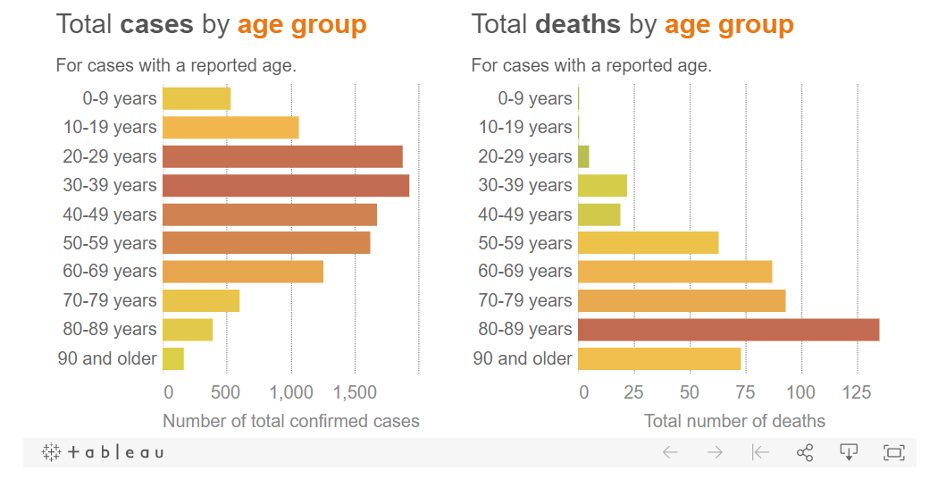

Slide 11
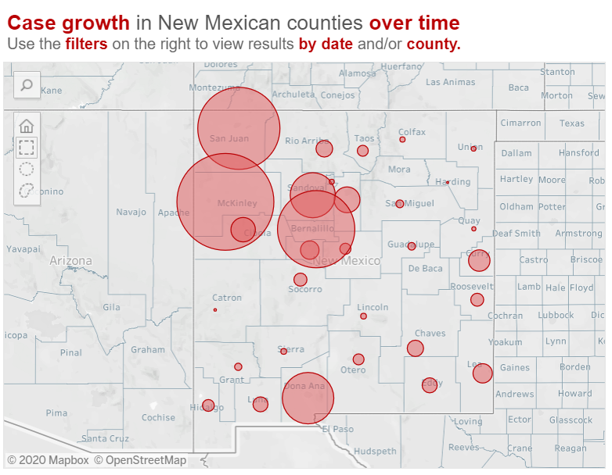

Slide 12
Sources
https://www.dailylobo.com/article/2020/04/coronavirus-in-new-mexico-by-the-numbers
https://www.nejm.org/doi/pdf/10.1056/NEJMoa2020283
https://isogg.org/wiki/Single-nucleotide_polymorphism#:~:text=A%20single%2Dnucleotide%20polymorphism%20(SNP,paired%20chromosomes%20in%20an%20individual.
https://cv.nmhealth.org/
https://www.the-scientist.com/news-opinion/dna-could-hold-clues-to-varying-severity-of-covid-19-67435
https://www.the-scientist.com/news-opinion/why-some-covid-19-cases-are-worse-than-others-67160

